Slide 1
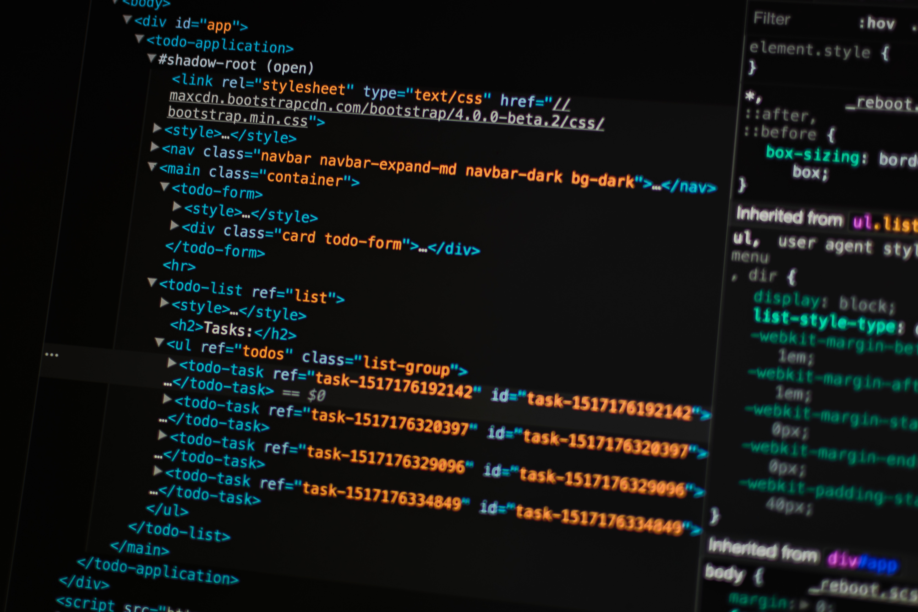


Herramientas para la recolección de datos web Yu-Chang (Andy) Ho May 8th, 2019, Colombia

Slide 2


About Me
Andy Ho (Yu-Chang Ho)
Consultant @ ECLAC, United nations
M.S. in Computer Science @
University of California, Davis
Work Experience
Research Assistant @
Academia Sinica, Taiwan
Education
B.S. in Computer Science @
National Central University, Taiwan

Slide 3

Outline
Web-scraping?
How to perform web-scraping?
What is API?
What should be aware of?
Technical skills for web-scraping?
Our achievements
Challenges?

Slide 4

Web-scraping!
(Crawling?)
1/28

Slide 5
What is web-crawling?
Collecting a list of webpage links
(Uniform Resource Locator, URL)
We called such a program
“web crawler”
World-wide Web (WWW)
Web Crawler
List of Targets to Visit
2/28

Slide 6
What is web-scraping?
Getting the data from the web!
You will have target.
Wikipedia
Scraping is a form of copying, in which specific data is gathered and copied from the web.
World-wide Web (WWW)
Web Crawler
Content Parsing
Basic Cleaning
Web Scraper
File
Database
3/28

Slide 7
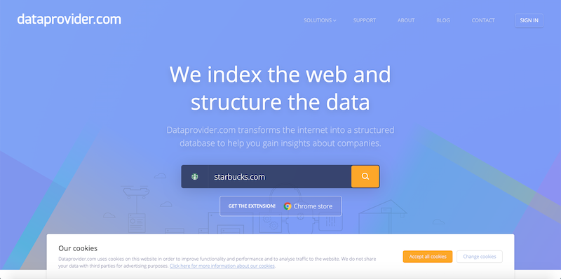
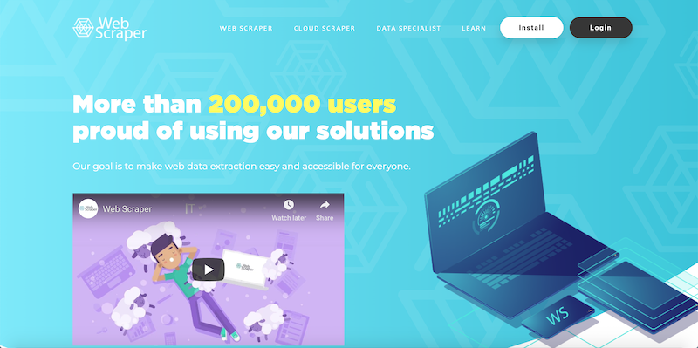
How to perform web-scraping?
Software
Listly (https://listly.io)
Web Scraper IO (https://www.webscraper.io)
Buy the data!
Dataprovider.com (https://www.dataprovider.com)
4/28

Slide 8




How to perform web-scraping?
What else?
Copy & Paste (Human Intelligence Solution)
Programming!!!
What will you need?
A programmer!
5/28

Slide 9
Recall the structure of a Web-scraper
Web Crawler
Content Parsing
Basic Cleaning
Web Scraper
6/28

Slide 10
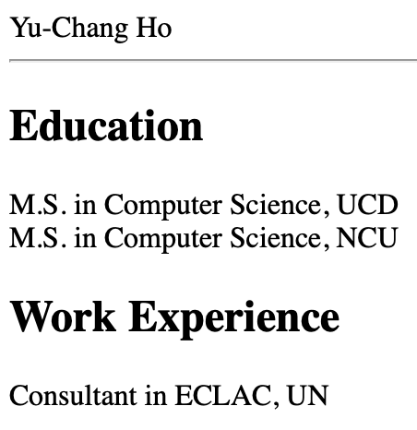
Content Parsing??
A webpage is essentially a file of texts.
<html>
<head>
<title>An Example</title>
</head>
<body>
<div id=“name”>Yu-Chang Ho</div>
<hr height=“2px”>
<h2>Education</h2>
<div id=“edu1”>M.S. in Computer Science, UCD</div>
<div id=“edu2”>M.S. in Computer Science, NCU</div>
<h2>Work Experience</h2>
<div id=”work1”>Consultant in ECLAC, UN</div>
</body>
</html>
7/28

Slide 11
Have a deeper look……
A HTML Element :
is a type of element, a container of any other elements or texts.
Other example: , , , ……
id=“name” is an identifier of a specific element.
<div id=“name”>Yu-Chang Ho</div>
<div>
<table>
<img>
<p>
8/28

Slide 12
So what does the parser do?
Read the webpage source.
Libraies like BeautifulSoup or Selemium could help you with this.
Find the target elements.
Collect the values.
Repeat 1. ~ 3. for all the crawled pages.
9/28

Slide 13
Essentially……
<html>
<head>
<title>An Example</title>
</head>
<body>
<div id=“name”>Yu-Chang Ho</div>
<hr height=“2px”>
<h2>Education</h2>
<div id=“edu1”>M.S. in Computer Science, UCD</div>
<div id=“edu2”>M.S. in Computer Science, NCU</div>
<h2>Work Experience</h2>
<div id=”work1”>Consultant in ECLAC, UN</div>
</body>
</html>
name | edu1 | edu2 | work1
Yu-Chang Ho | M.S. in Computer Science, UCD | M.S. in Computer Science, NCU | Consultant in ECLAC, UN
10/28

Slide 14
Recall the structure of a Web-scraper
Web Crawler
Content Parsing
Basic Cleaning
Web Scraper
11/28

Slide 15
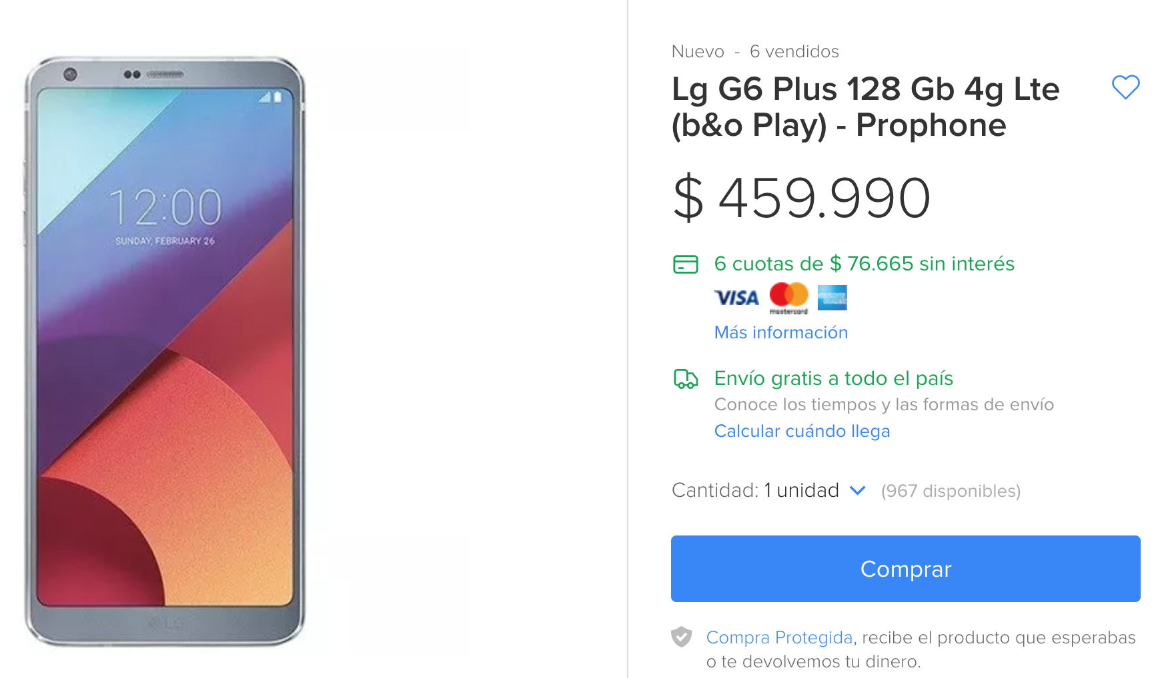
Data Cleaning
Format the scraped values
De-duplication
Eliminate outliers
12/28

Slide 16
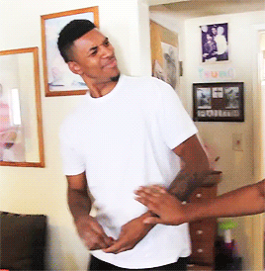
What is an API?
Application Programming Interface
(API)
The API is a service to easily access data!
Data in uniform format like CSV, JSON, or XML.
Not all the website provides this service…….
Indicates the willingness of the company for sharing their data!
13/28

Slide 17
JavaScript Object Notation (JSON) A set of Key/Value pairs.
{
"id": "MSV418788",
"name": "Accesorios Náuticos",
"picture": null,
"permalink": null,
"total_items_in_this_category": 0,
"children_categories": [],
"attribute_types": "none",
"meta_categ_id": null,
"attributable": false
}
14/28

Slide 18
Extensible Markup Language (XML) Similar to HTML.
<root>
<row>
<id>&apos;MCR423578486&apos;</id>
<name>Parrot Drone Bebop 2 Fpv ...</name>
<symbol (original)>CRC</symbol (original)>
<price (original)>459000.0</price (original)>
<price (USD)>762.9143380796195</price (USD)>
<sold>4.0</sold>
<country>Costa Rica</country>
</row>
</root>
15/28

Slide 19
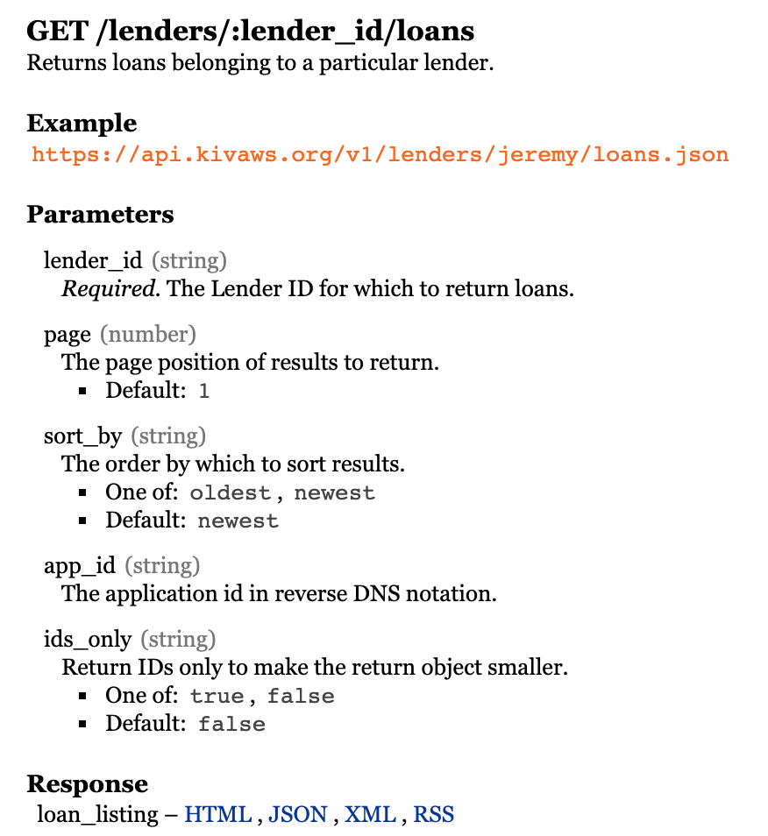
About API
Always provided with documentations for the usage.
The address to access
Parameters
(Sorting, Filtering)
Data Format
16/28

Slide 20
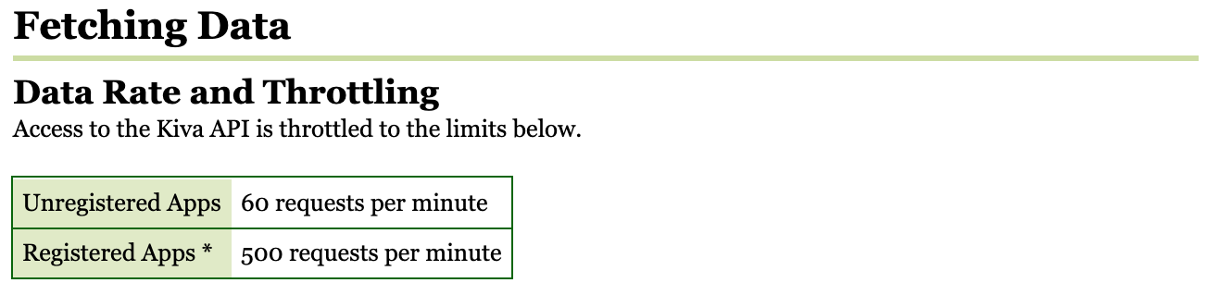
About API
Has limitations for accessing
Authentication (Access Token, Valid User Account)
Limited Number of Requests
Key = “YUCAKJ19090242539KKIL”
17/28

Slide 21

API or Web-scraping?
API | Web-scraping
Granted to use the data | Not grant to use
No need to make a complex parser | Need to design the parser
No need to clean the data | Need to make sure the data obtained is correct
Easy to use (as a programmer perspective) | Some companies can prevent the data from being scraped
Have rules to follow, not a security issue | Kind of security attack
18/28

Slide 22

API will always be the recommended way!!
(Of course, if provided……)
19/28

Slide 23

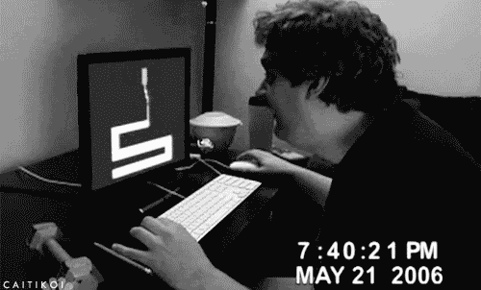
What Should be aware of when collecting data?
Terms & Conditions provided by the website
The ability of the server of the website (How much requests at the same time?)
Random wait time
The network status of your machine
You computer could crash!!!
20/28

Slide 24




Technical skills for web-scraping
Software development
Knowledge of Databases
(Relational, NoSQL)
Server Management
(Linux, Windows)
21/28

Slide 25

What we achieved
Target | Data Points through Scraping | Data Points through API
MercadoLibre (Items) | 192092 (192K) | 5343091 (53.4M)
MercadoLibre (Sellers) | 25679 (25K) | 2474157 (2.4M)
Kiva | N/A | 1684119 (1.6M)
Twitter | N/A | 104724059 (104M)
Freelancer.com | N/A | 191424 (191K)
WORKANA | 20456 (20K) | N/A
Over 150 Million data points!!!
23/28

Slide 26
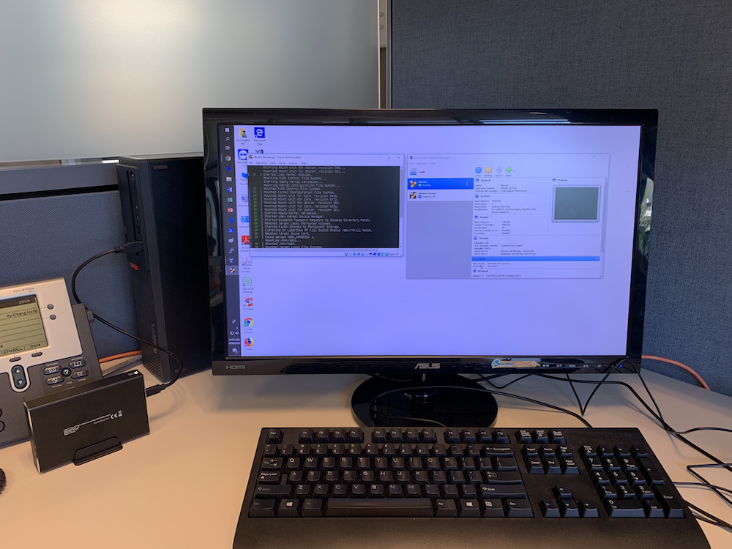
Our Infrastructure
24/28

Slide 27

Architecture
World-wide Web (WWW)
Advanced Data Cleaning
Normalization
Web Crawler
De-dupe
Database
Content Parsing
Aggregation
Basic Cleaning
Web Scraper
File
Error Handling & Retry
Visualization
25/28

Slide 28

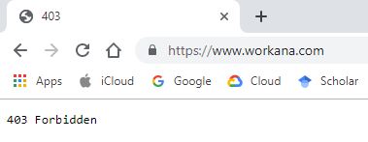
Challenges?
Infrastructure
Been blocked by the target sites for doing the scraping
Cafeteria, Public WiFi
Program errors handling
Observing the behavior of the website
Data cleaning
Time Consuming!!!
26/28

Slide 29


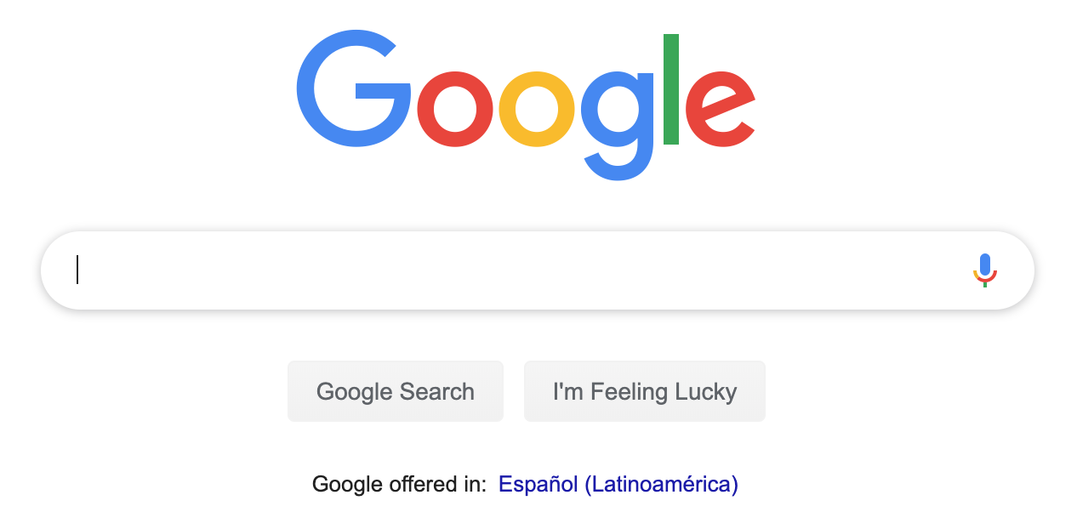
Did I mention observing the behavior of the website?
Magic happens in background!!!
Open a webpage is essentially downloading files from the server.
1. Open www.google.com
2. Send webpage source to the browser
3. Browser execute the source
27/28

Slide 30
Live Demo!
Sample Website:
https://www.freelancer.es/freelancers/
28/28

Slide 31
References
https://www.wikiwand.com/en/Web_scraping
https://www.wikiwand.com/en/Web_crawler
https://www.promptcloud.com/blog/data-scraping-vs-data-crawling/
https://www.promptcloud.com/blog/best-programming-language-for-web-scraping/
https://www.wikiwand.com/en/Application_programming_interface

Slide 32

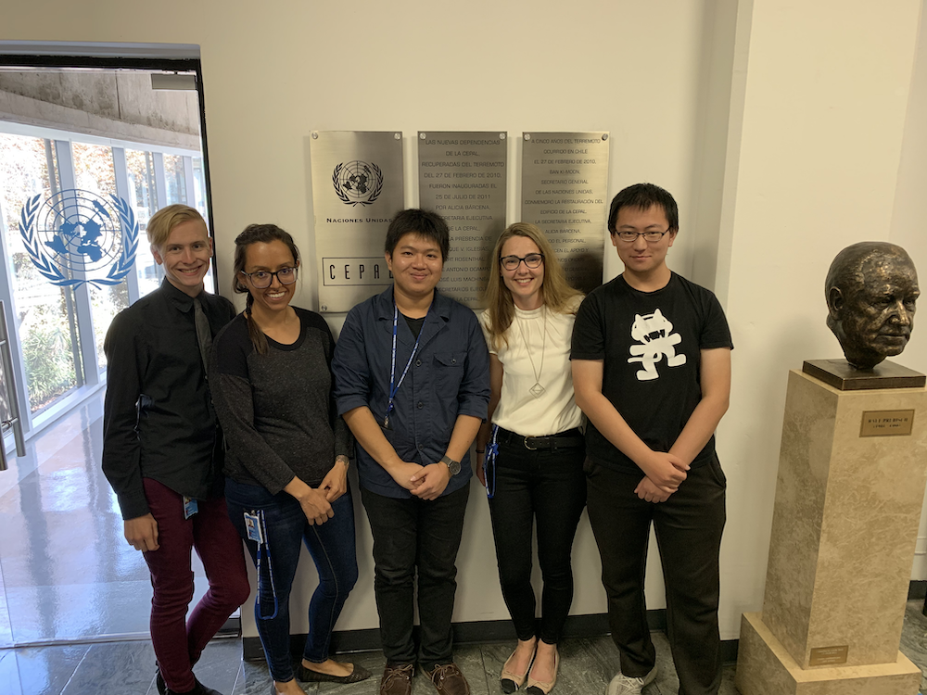
Thank you! Questions?
My teammates (from left to right):
Matthew Reese, Karla Rascon-Garcia, Me, Veronika Vilgis, Xin Jin

